Slide 1
College Career & Life Readiness
Woodland Public School Board • January 8, 2018

Slide 2
The Future of the U.S. Workforce
The Limited Career Prospects for High School Graduates without additional Education and Training
Finding #1: The U.S. workforce will require more education and skills in the near future
Finding #2: Low skills jobs provide few opportunities for advancement or security
Finding #2: The skills mismatch is real
Finding #4: There are many pathways to middle and high skill jobs, but education and training be3yond high school is the common denominator

Slide 3
The Future of the U.S. Workforce
The Limited Career Prospects for High School Graduates without additional Education and Training
The employment picture is bleak for individuals who do not continue their education beyond high school — and even more bleak for those who do not earn a high school diploma
Workers with only a high school education face not only more limited job prospects but also lower wages, lower prestige and more limited career advancement pathways.
If individuals want to have a foothold in the middle class, then they will need to pursue additional education and training to access middle and high skills jobs.
It is clear that a K–12 education that prepares graduates for entry — without remediation — into postsecondary pathways gives them the best foundation from which to make choices about their careers — choices that are predicated on more options and more doors being open rather than shut for lack of adequate academic preparation.

Slide 4
The Future of Jobs and Training
Theme 2: Learners must cultivate 21st‑century skills, capabilities and attributes
  Tough-to-teach intangible skills, capabilities and attributes such as emotional intelligence, curiosity, creativity, adaptability, resilience and critical thinking will be most highly valued

Slide 5

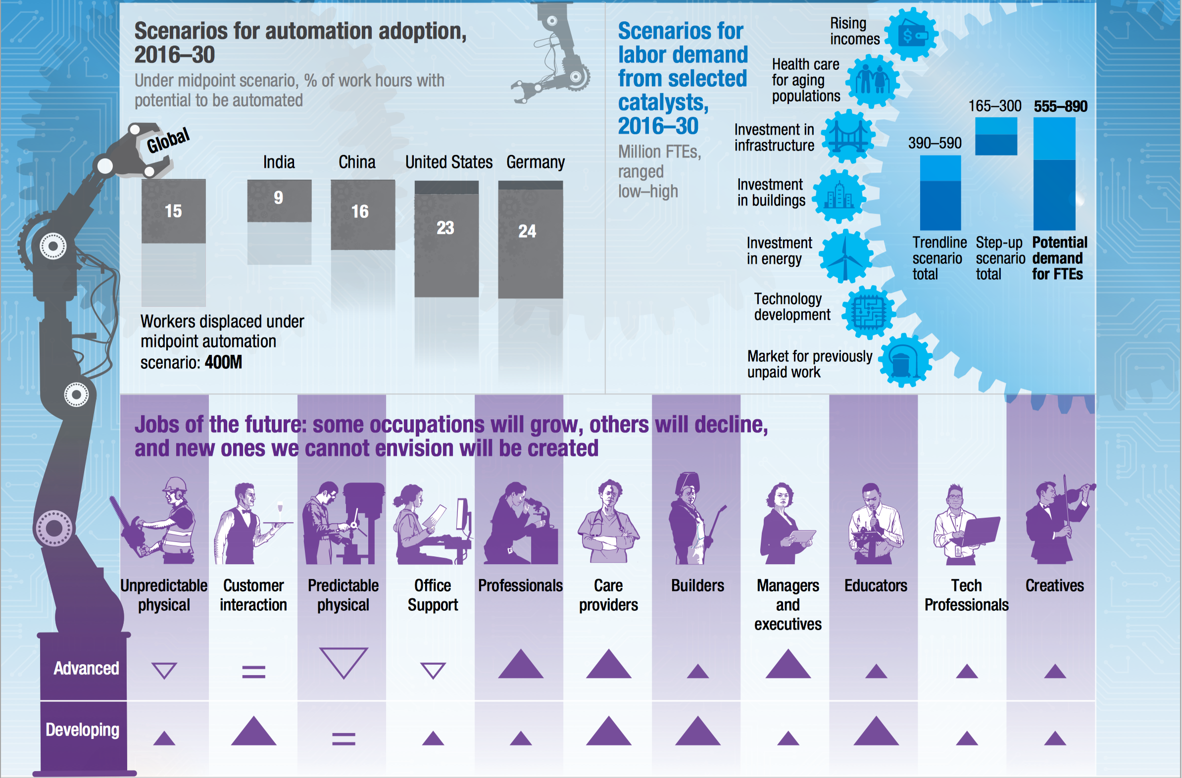

Slide 6

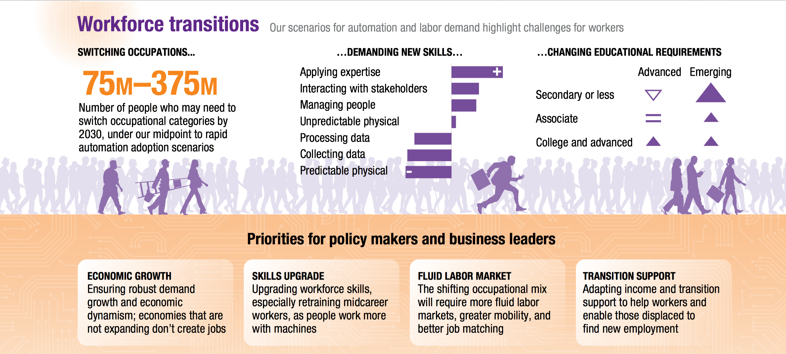

Slide 7
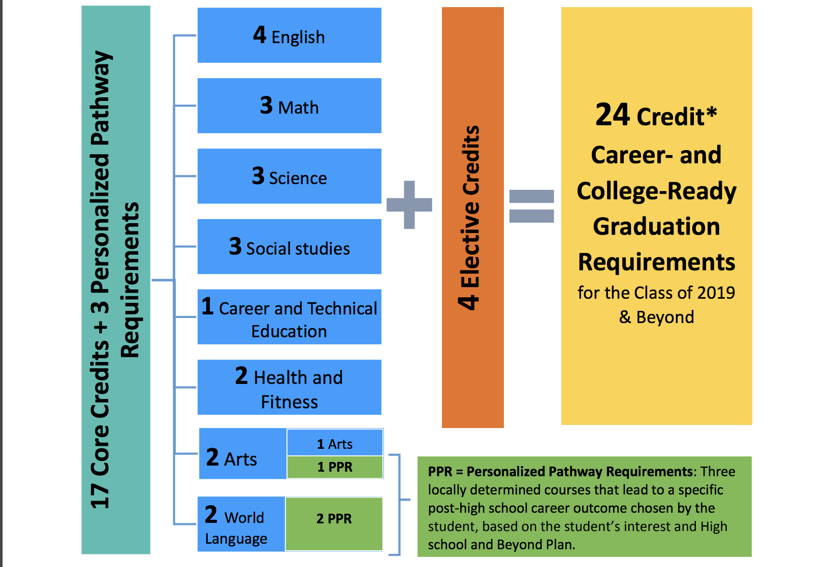

Slide 8
What is College and Career Readiness
By 2020 65% of all jobs and 92% of STEM Jobs will require postsecondary education and training. College and career ready graduates should be able to succeed in entry-level postsecondary courses without remediation.
Mastery of rigorous knowledge and skills in core academic disciplines
The skills and dispositions necessary to be successful in charting their postsecondary path
Successfully participated in postsecondary opportunities

Slide 9
Are They Really Ready to Work?
Partnership for 21st Century Learning
Top Five Most Important Skills
  Professionalism
  Teamwork
  Oral Communication
  Ethics & Social Responsibility
  Reading Comprehension

Slide 10
The 4C’s—”Super Skills for the 21st Century
Partnership for 21st Century Learning
Communication— Sharing thoughts, questions, ideas, and solutions
Collaboration— Working together to reach a goal — putting talent, expertise, and smarts to work
Critical Thinking— Looking at problems in a new way, linking learning across subjects & disciplines
Creativity— Trying new approaches to get things done equals innovation & invention

Slide 11
Career and Technical Education (CTE)
Programs for Woodland Students

Slide 14
WHS CLASS OF 2015 POST GRADUATE SURVEY
SPRING 2017

Slide 15
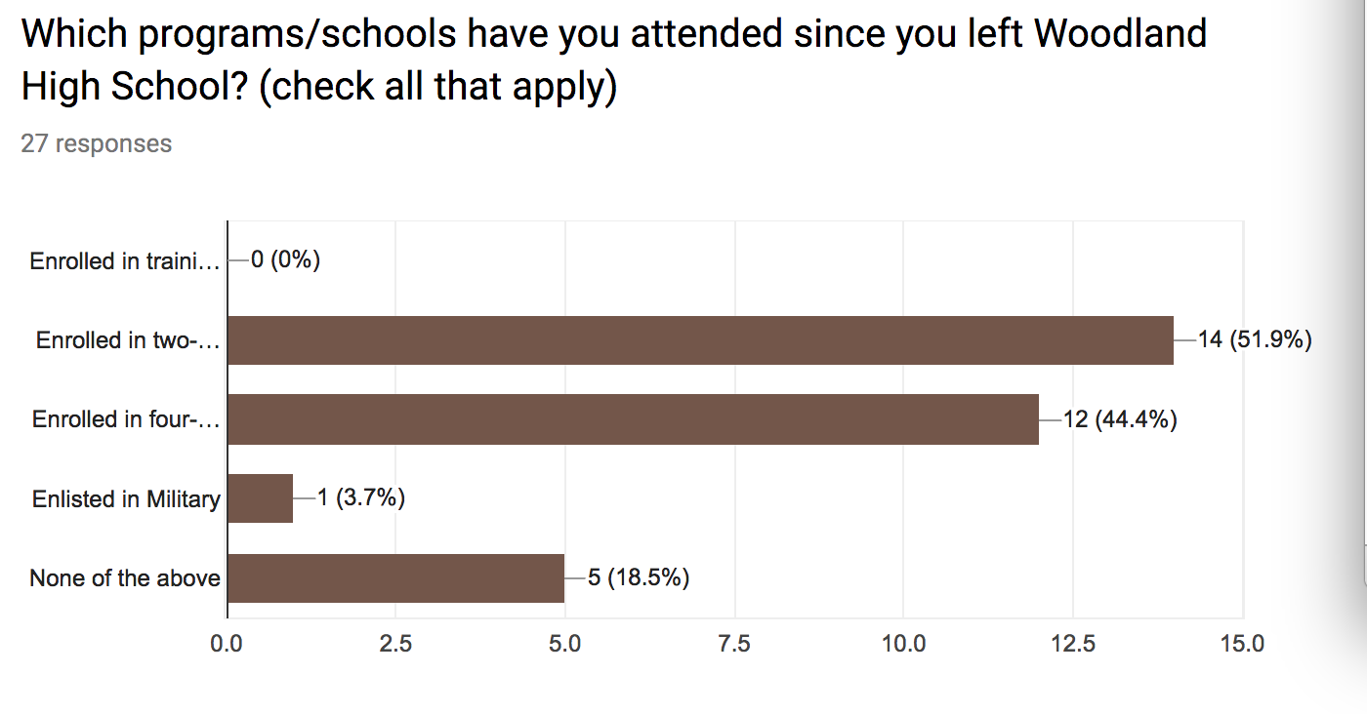

Slide 16
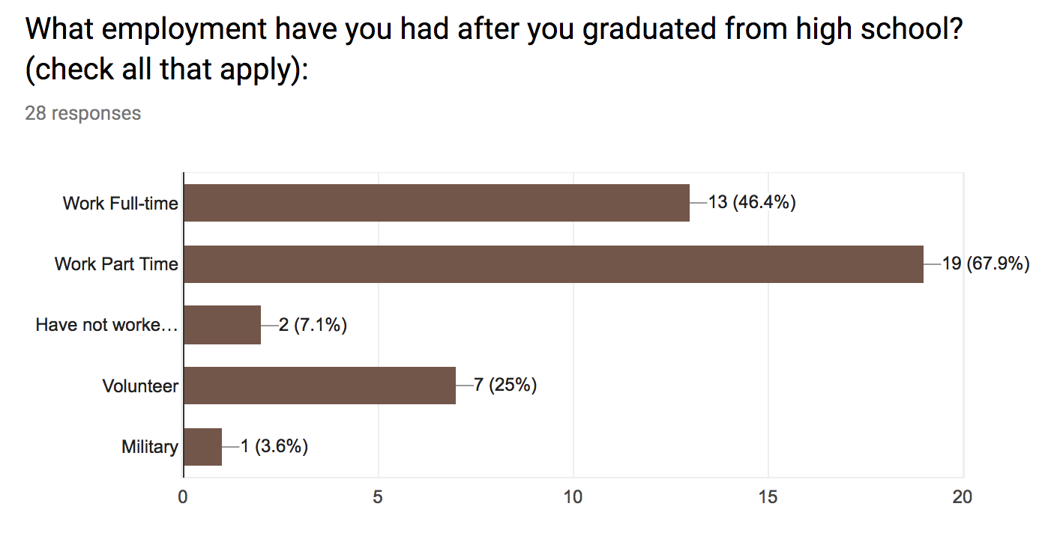

Slide 17
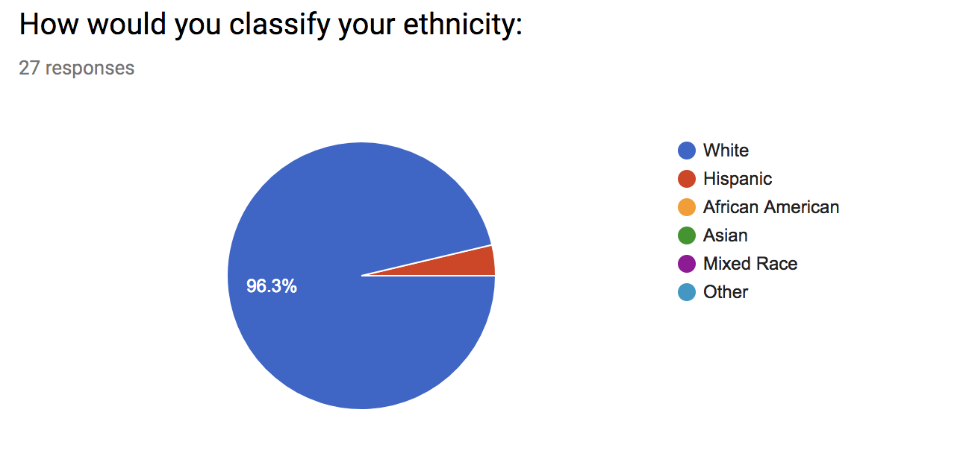

Slide 18
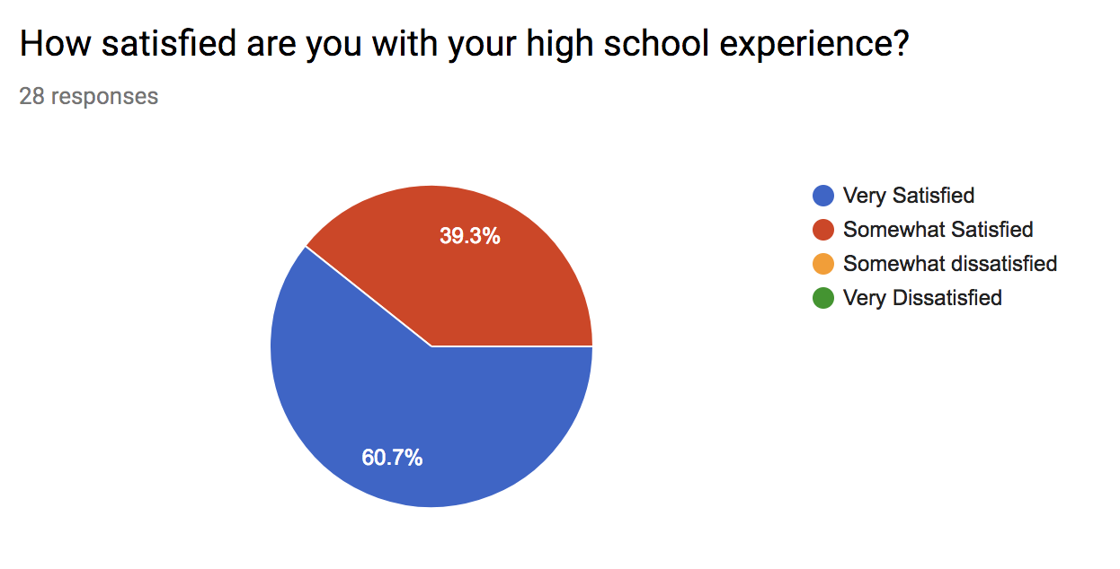

Slide 19
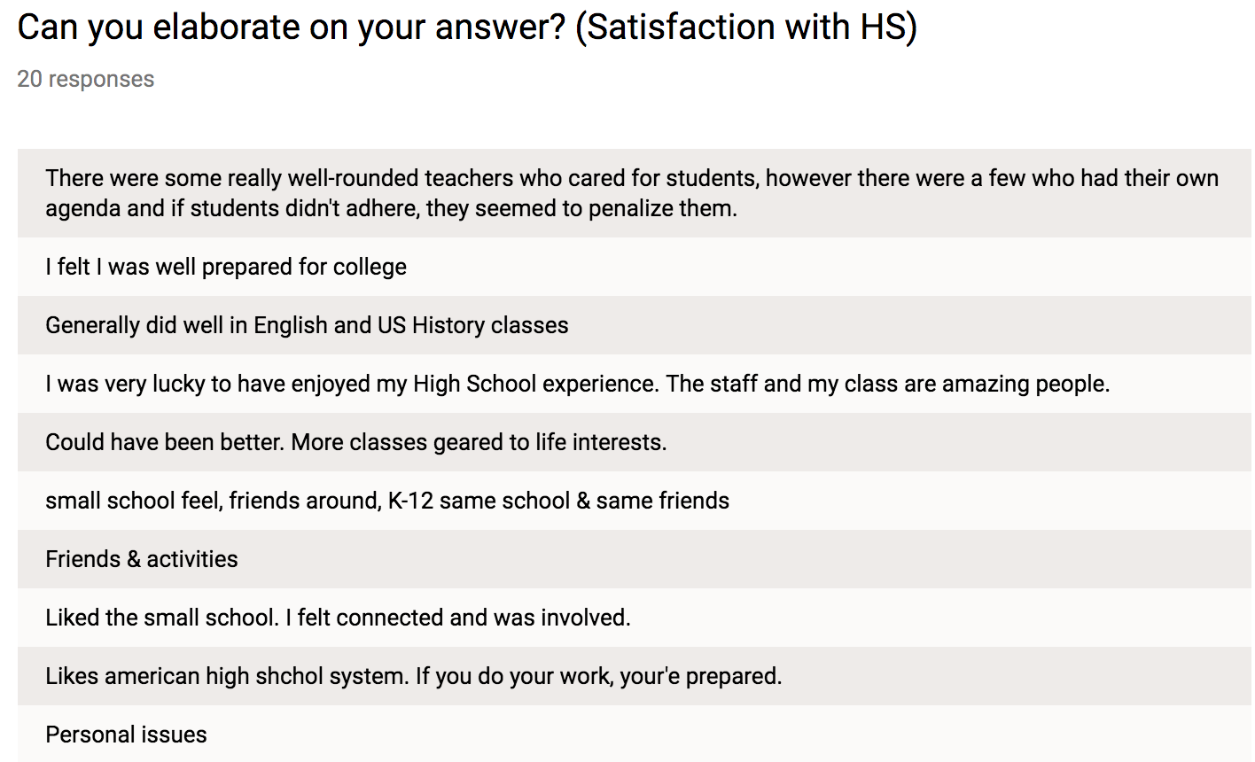

Slide 20
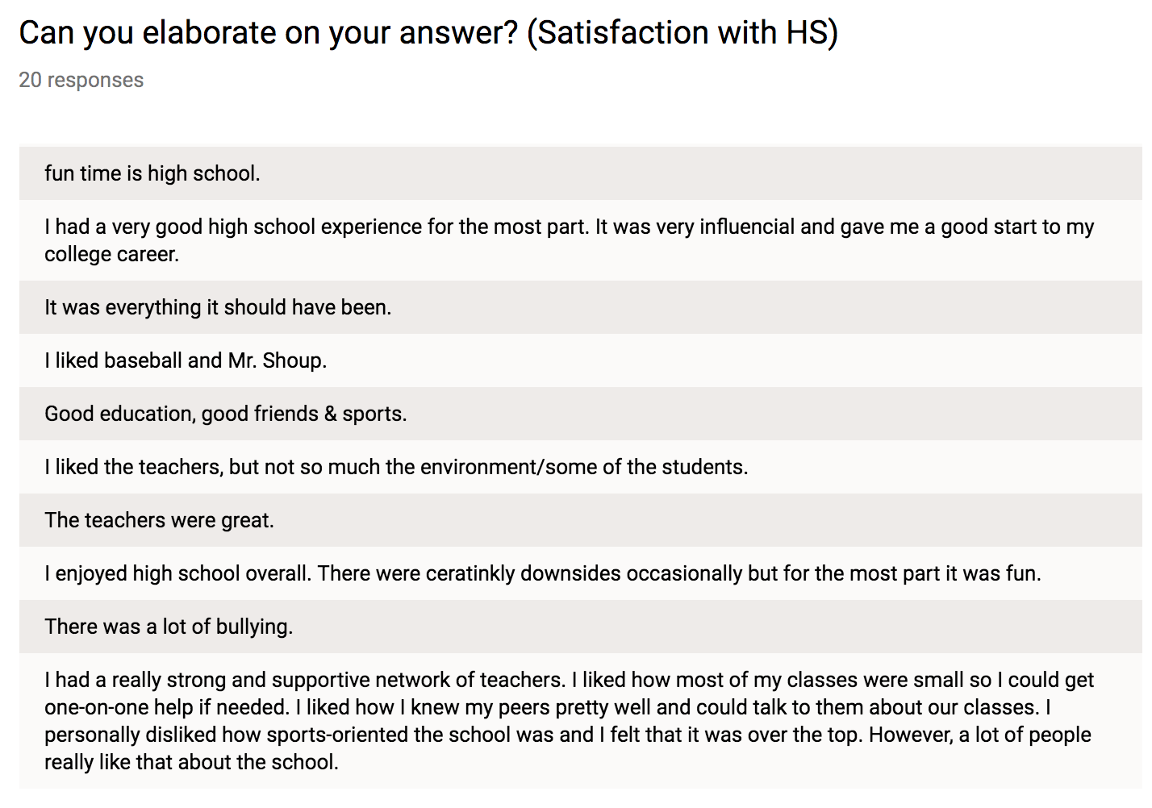

Slide 21
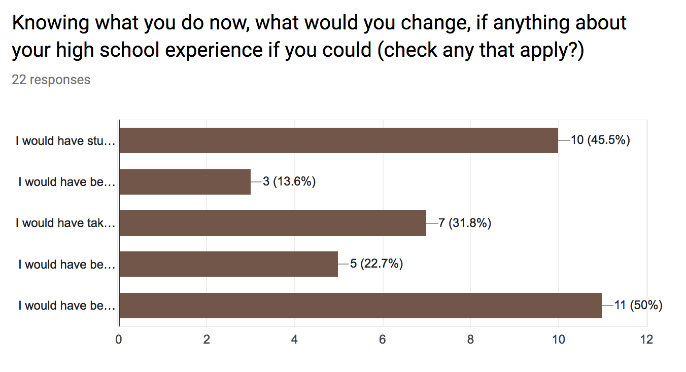

Slide 22
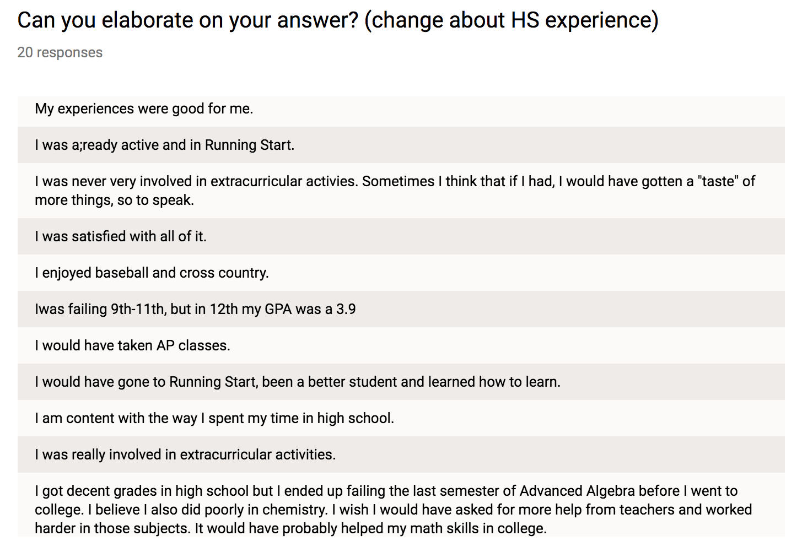

Slide 23
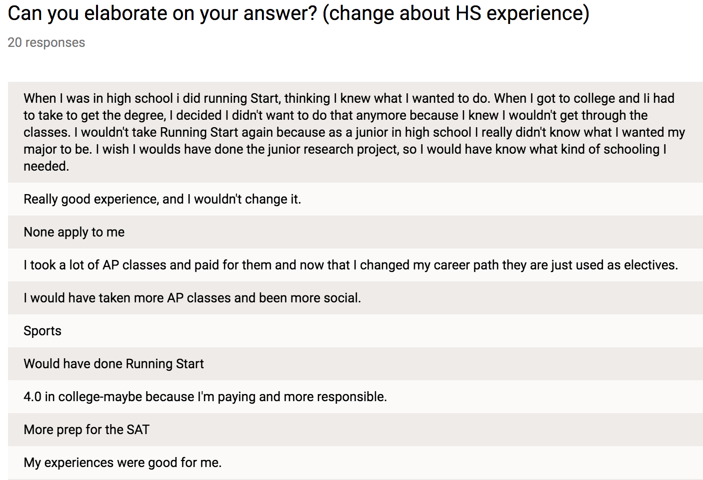

Slide 24
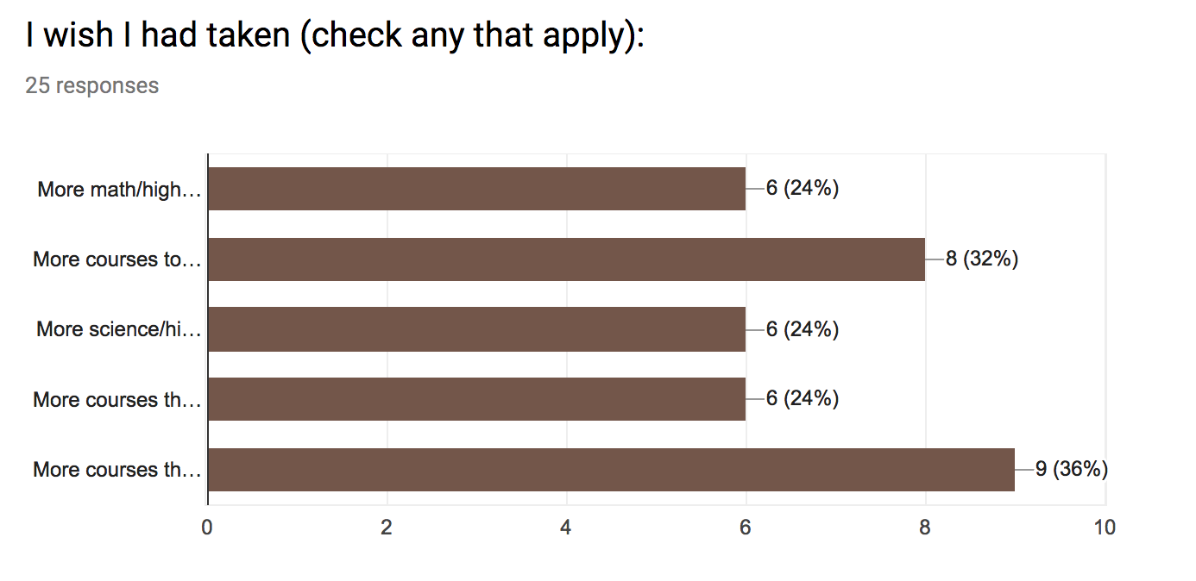

Slide 25
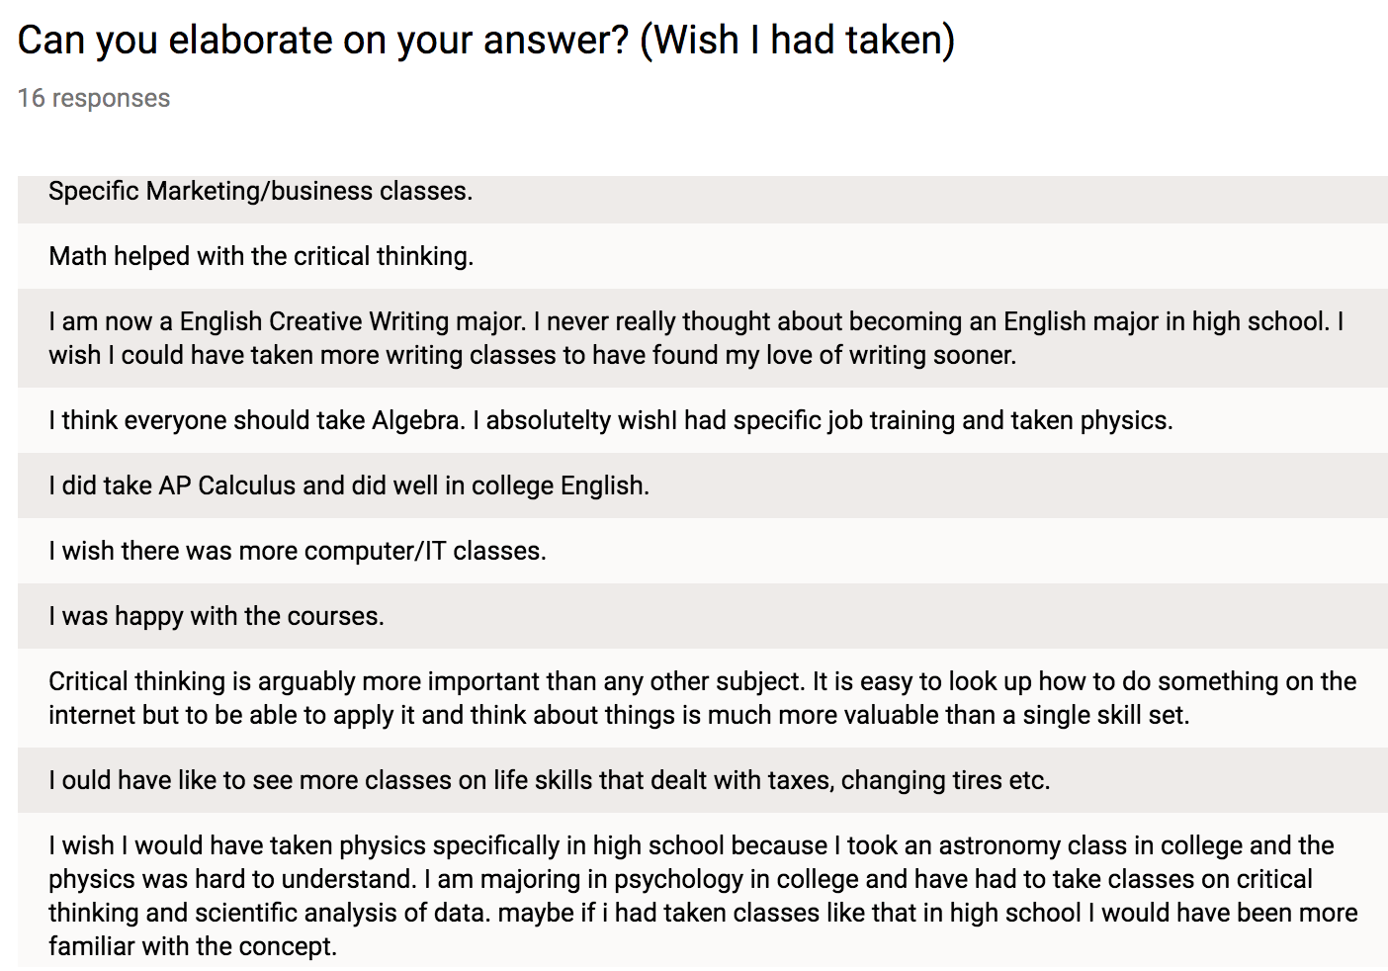

Slide 26
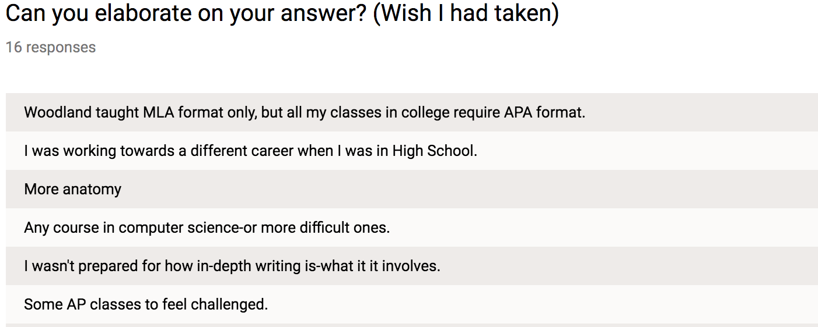

Slide 27
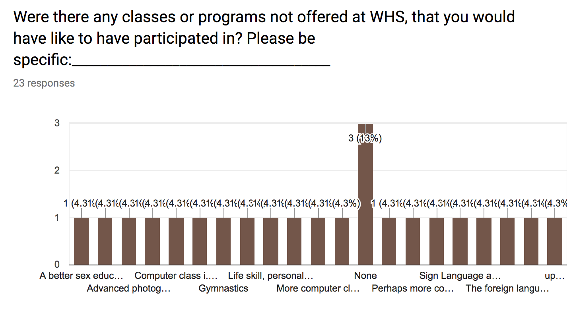

Slide 28
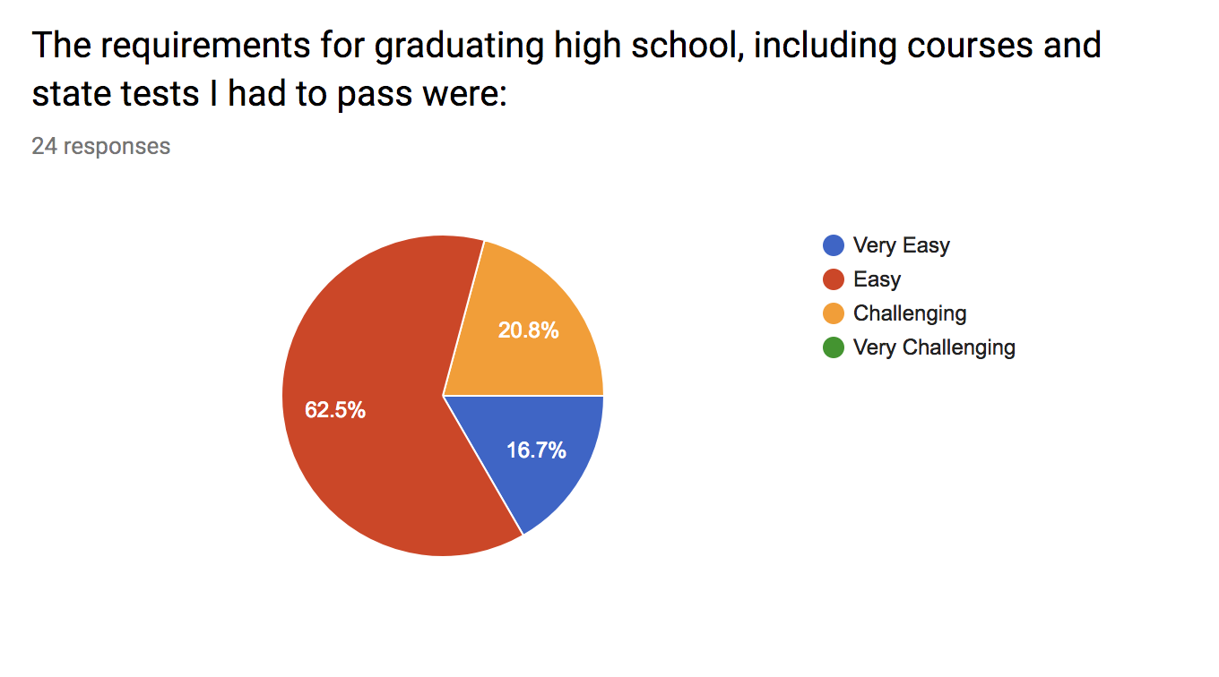

Slide 29
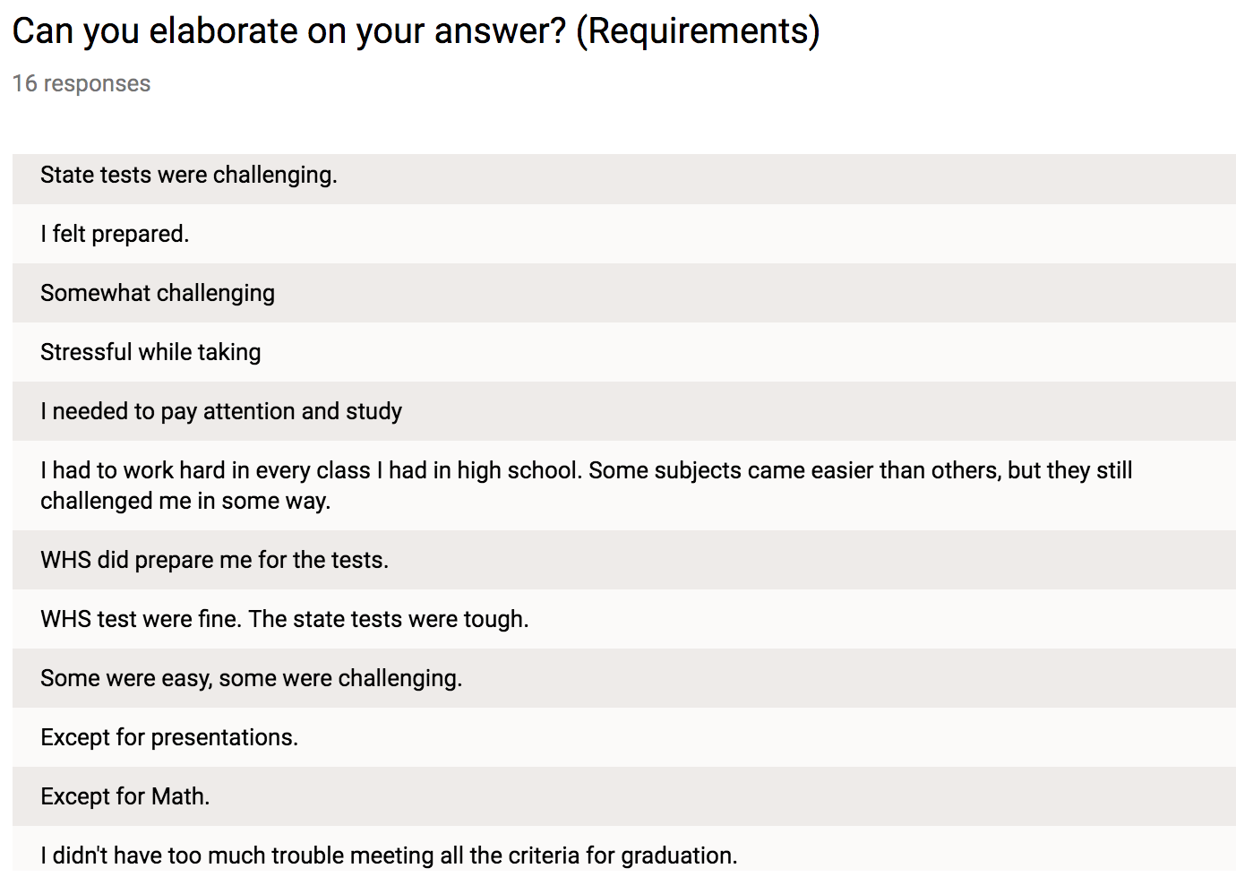

Slide 30
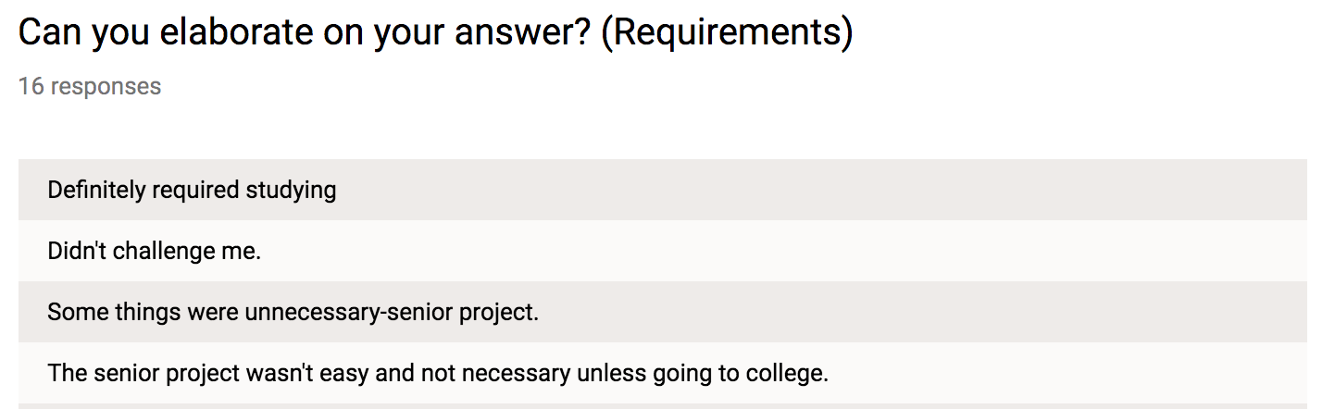

Slide 31
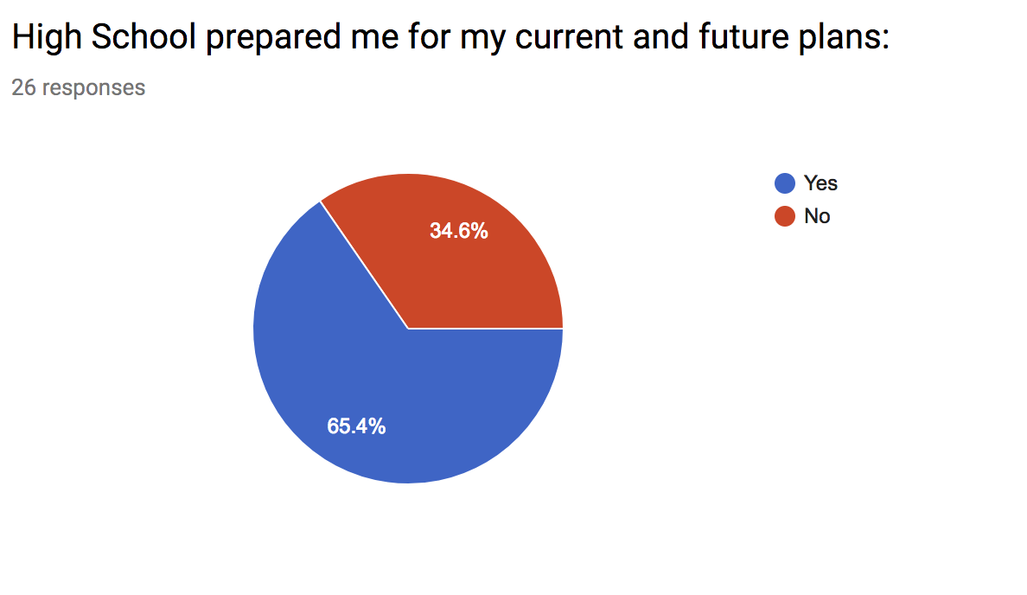

Slide 32
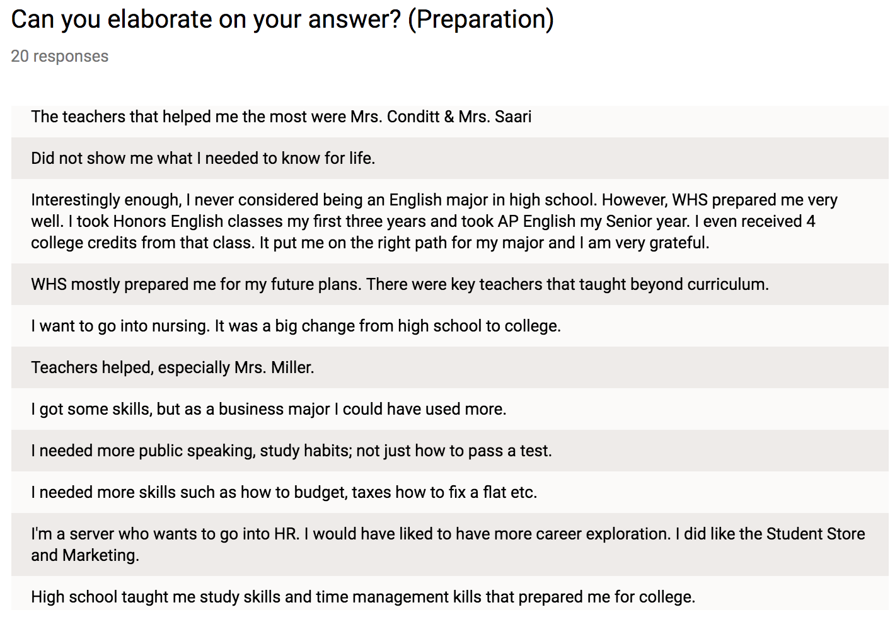

Slide 33
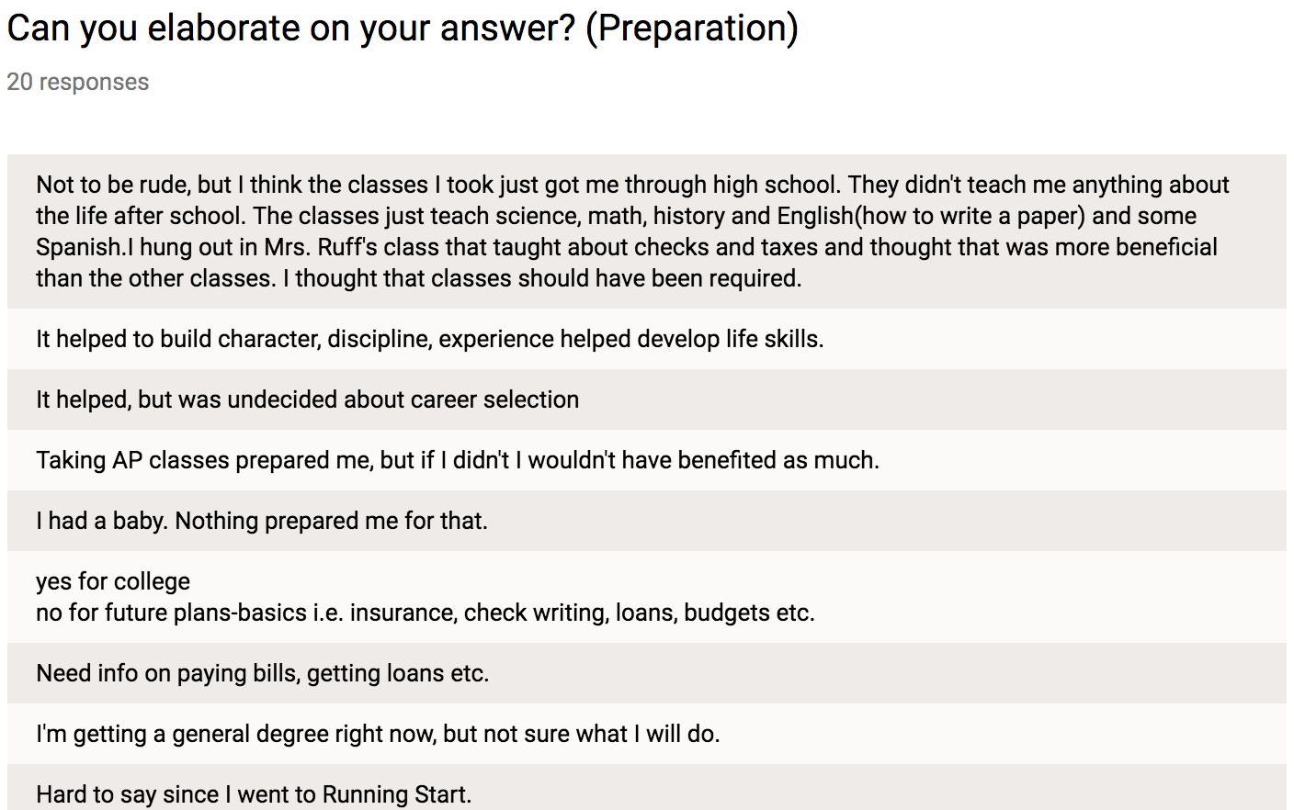

Slide 34
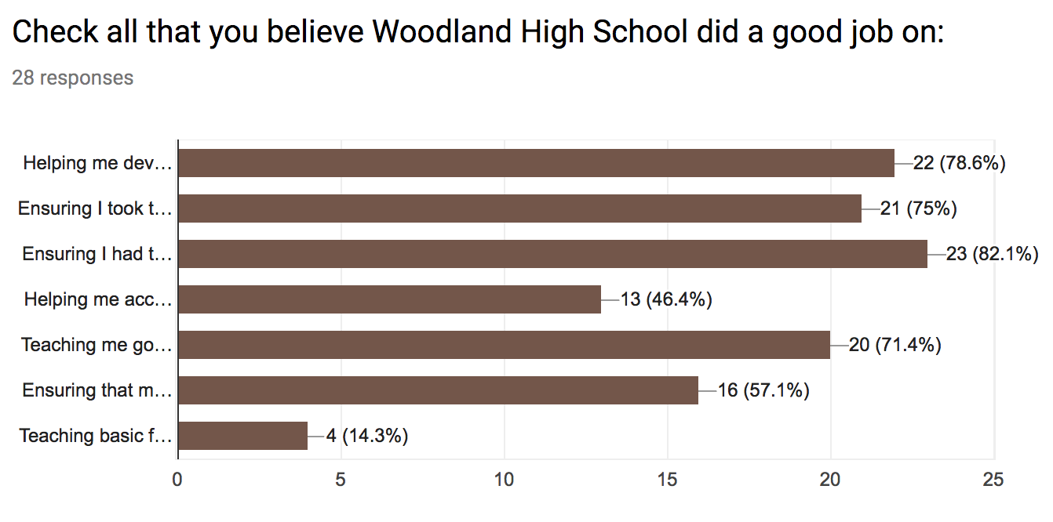

Slide 35
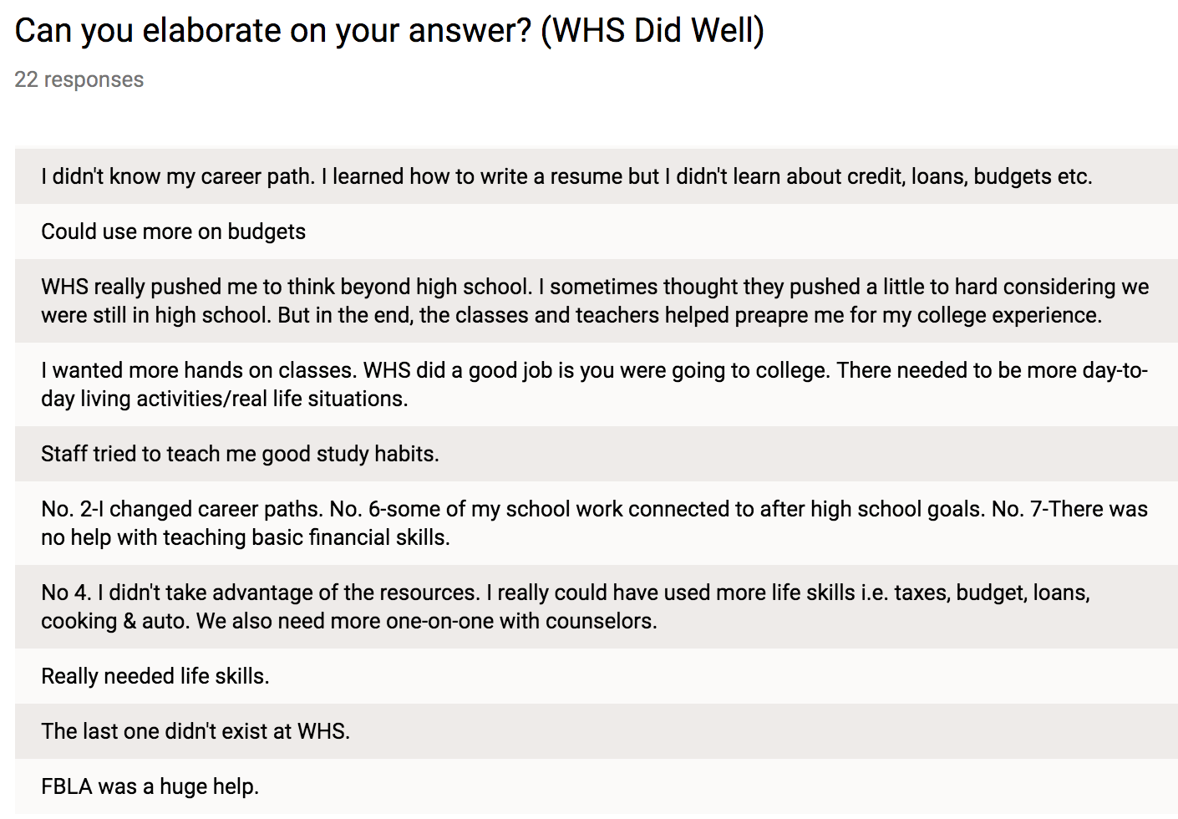

Slide 36
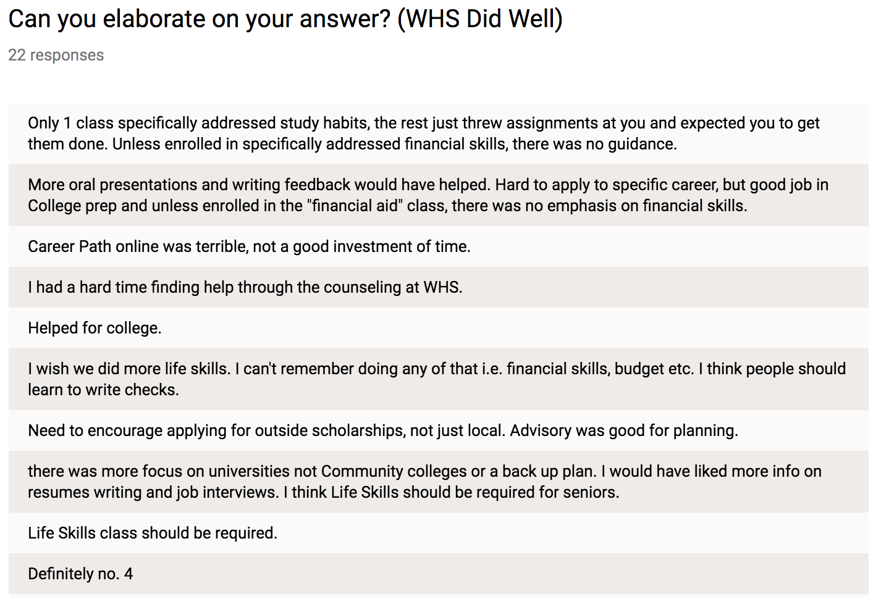

Slide 37
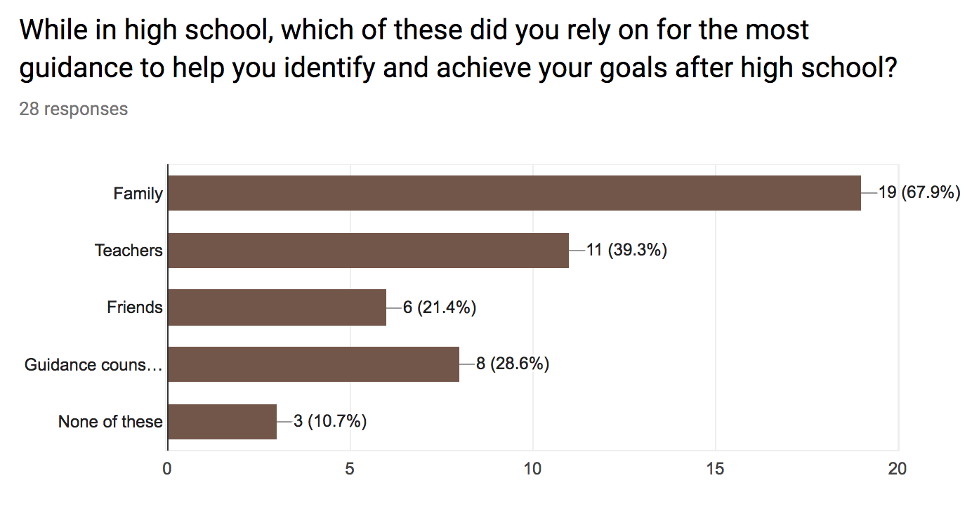

Slide 38
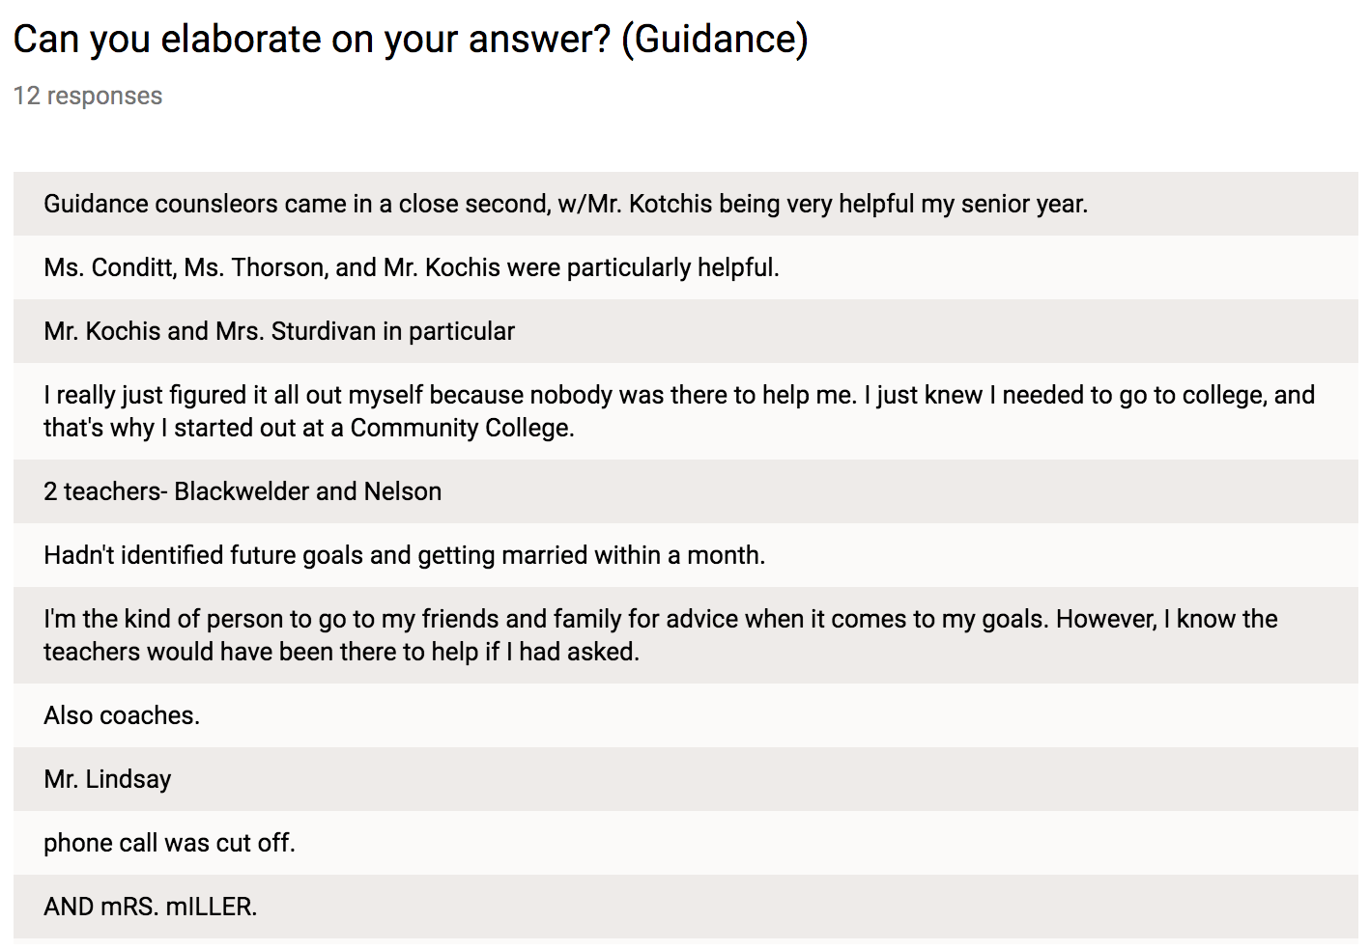

Slide 39
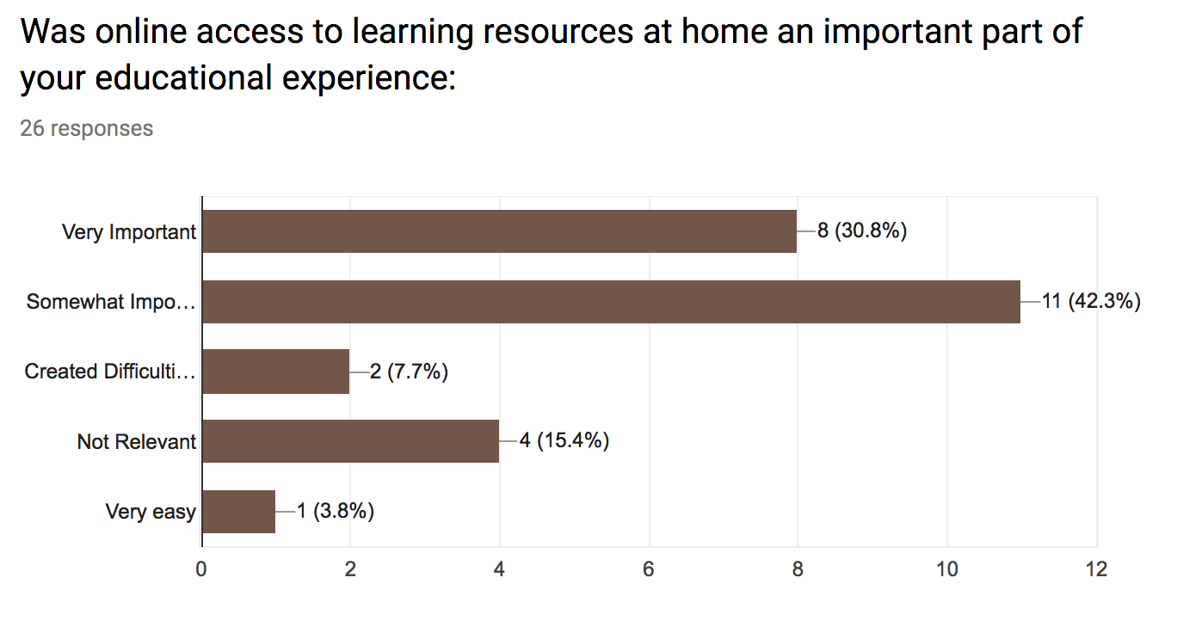

Slide 40
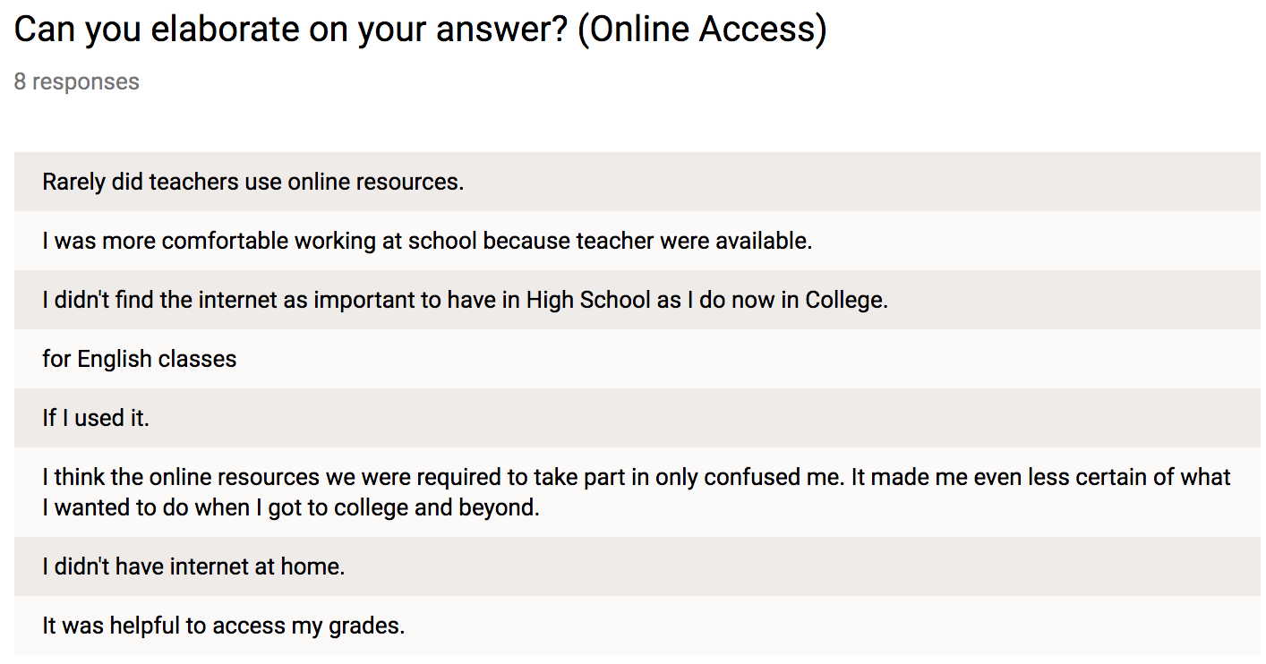

Slide 41
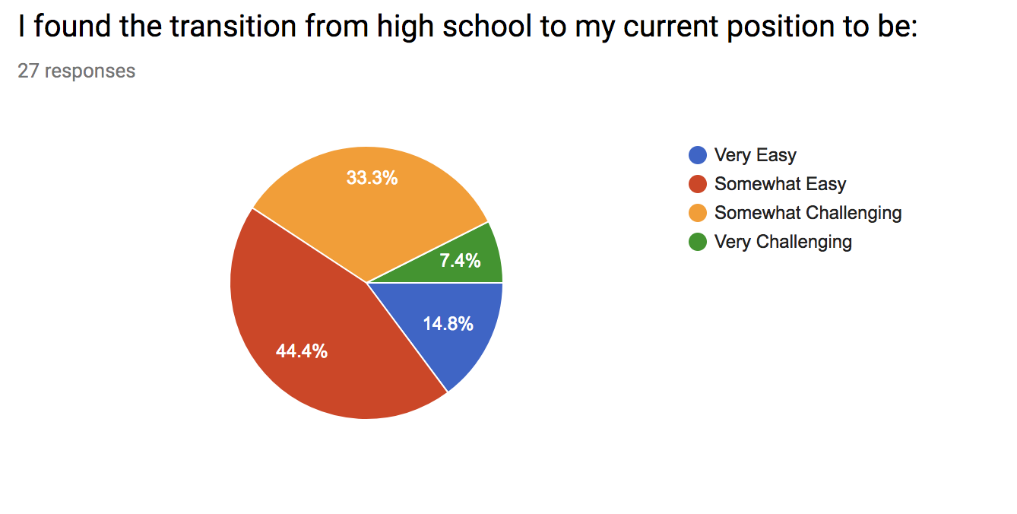

Slide 42
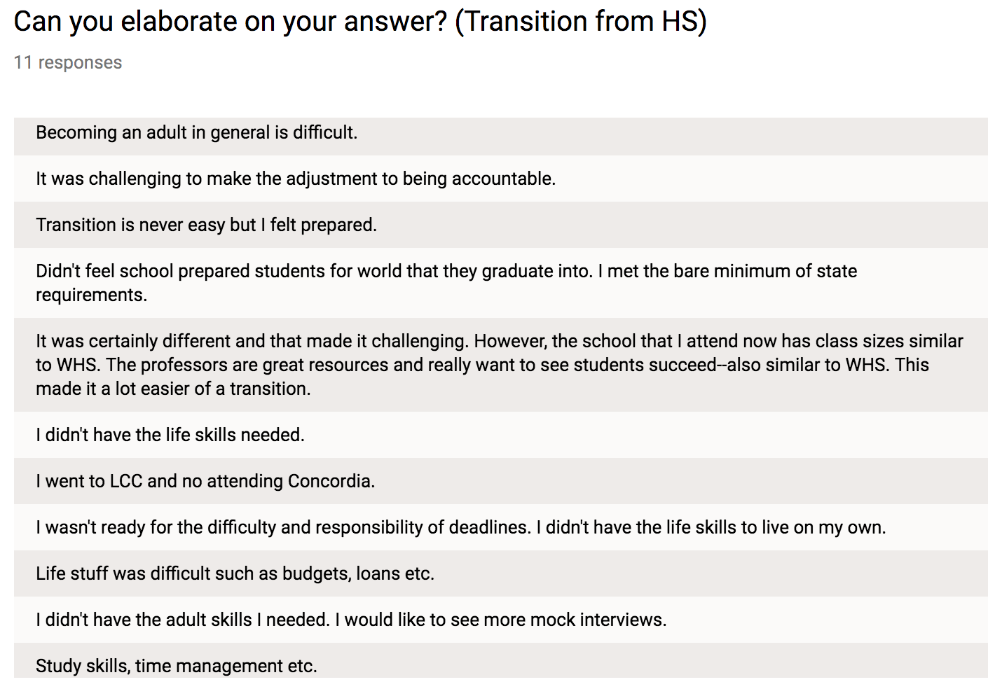

Slide 43
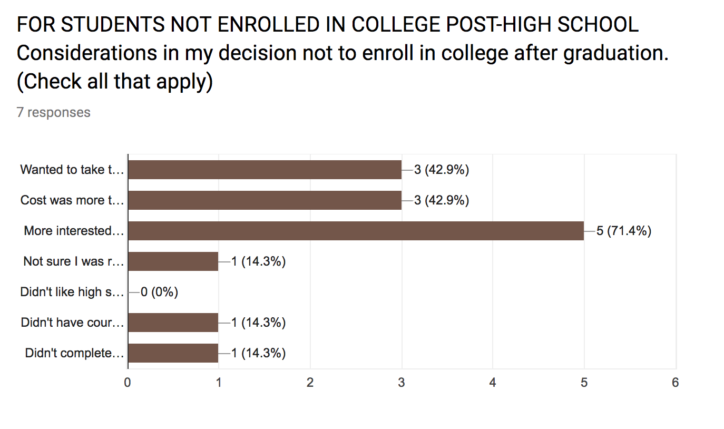

Slide 44
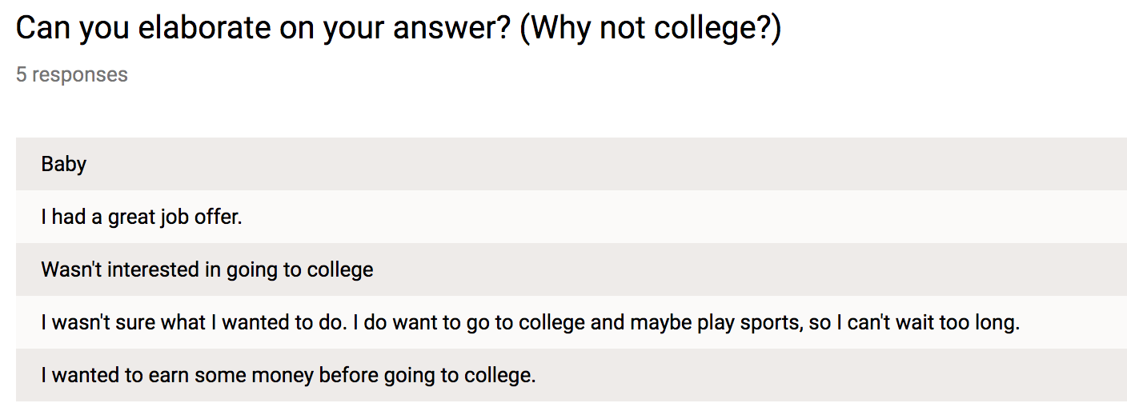

Slide 45
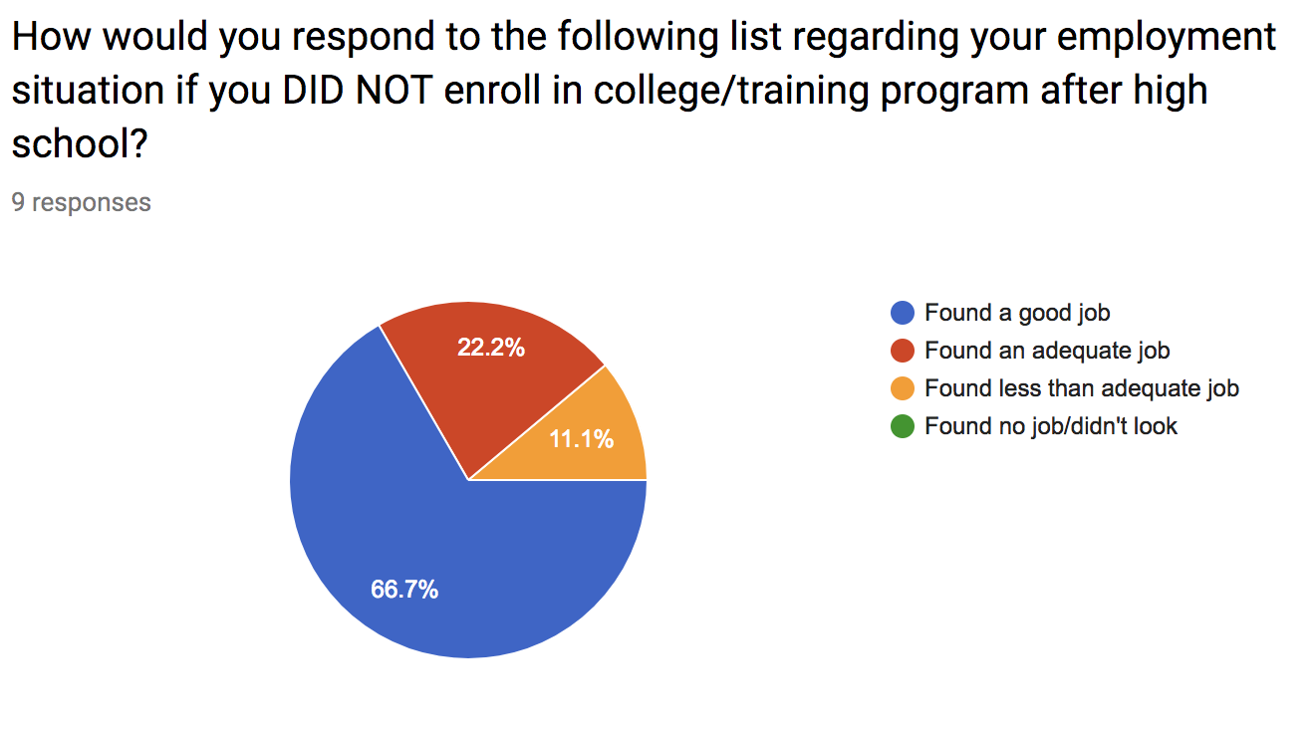

Slide 46
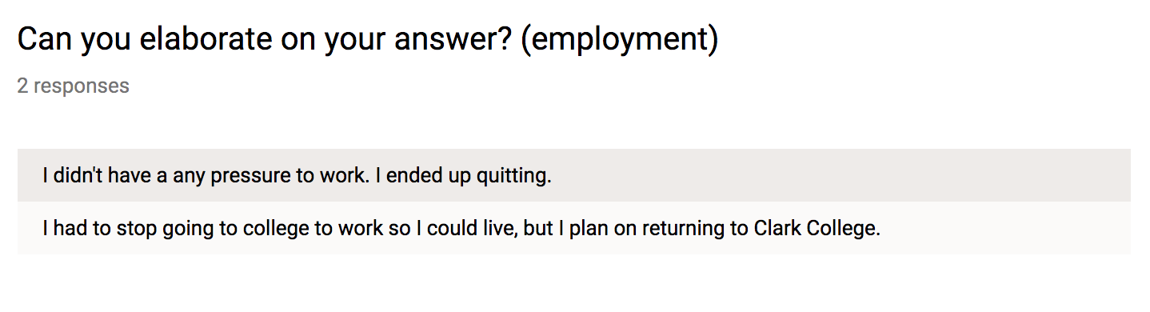

Slide 47
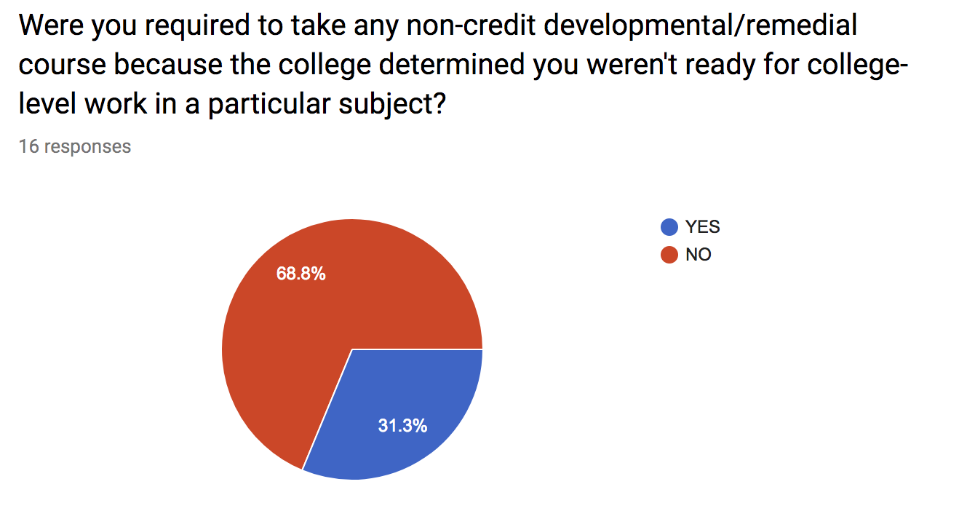

Slide 48
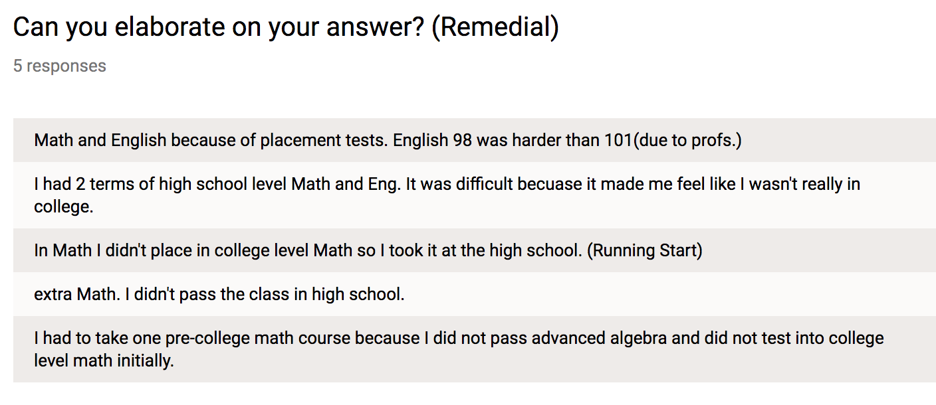

Slide 49
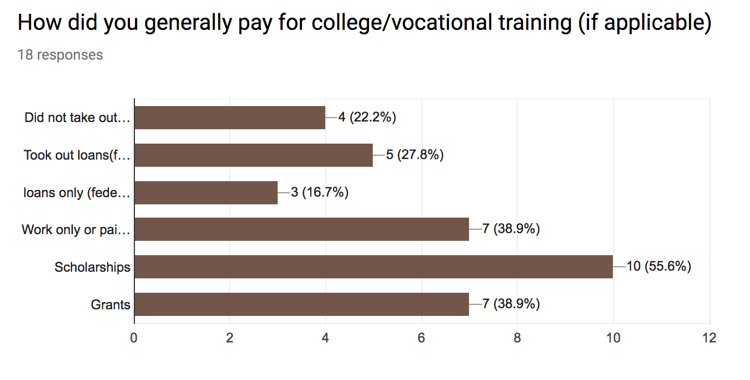

Slide 50
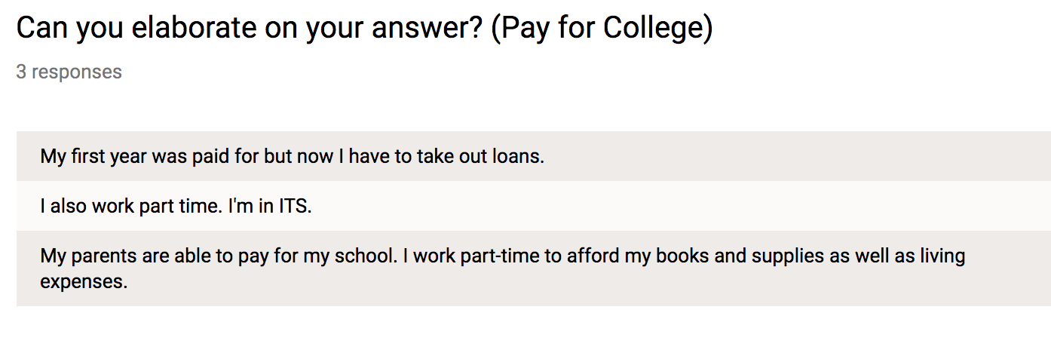

Slide 51
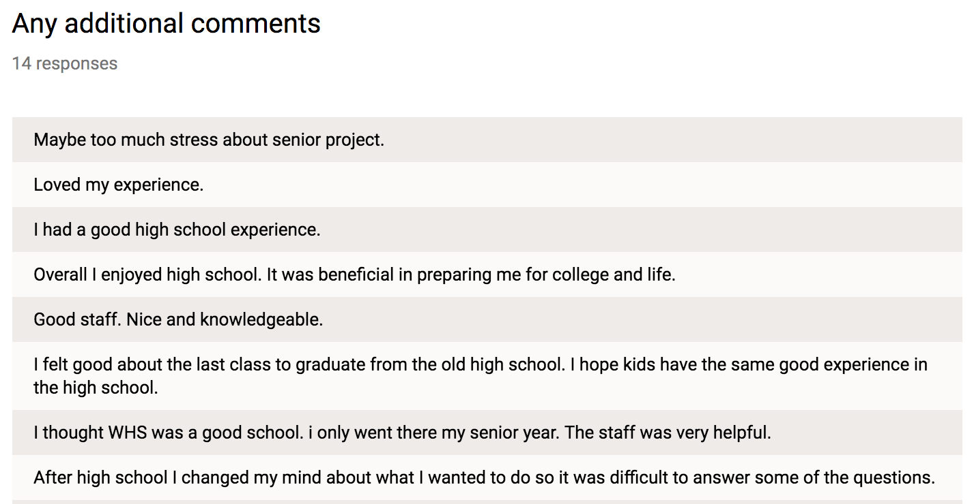

Slide 52
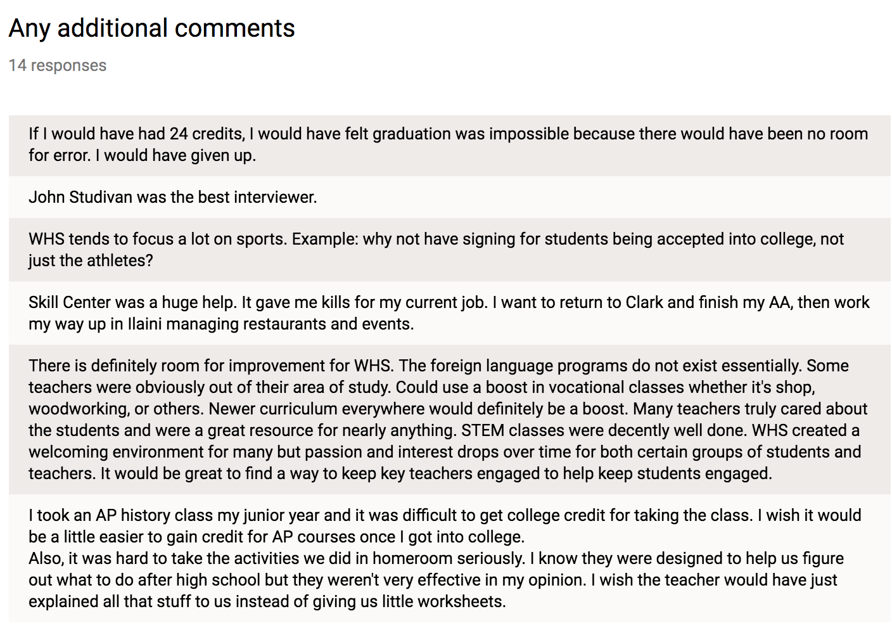

Slide 53
Senior Exit Survey Results 2012-2017

Slide 54
What areas to you plan to pursue after High School
 | 2012 | 2013 | 2014 | 2015 | 2017 | 2017
Working F/T | 17 | 15 | 27 | 16 | 13 | 17
Military | 7 | 13 | 9 | 5 | 7 | 7
4 yr College | 22 | 23 | 23 | 37 | 36 | 34
2 yr College | 48 | 38 | 25 | 23 | 28 | 26
Voc/Tech | 2 | 4 | 7 | 6 | 7 | 5
Other | - | 6 | 9 | 13 | 10 | 11

Slide 55
Were school counselors and teachers helpful in the selection of a path to follow after High School?
 | 2012 | 2013 | 2014 | 2015 | 2017 | 2017
Yes | 70% | 70% | 69% | 70% | 78% | 84%
No | 30% | 30% | 31% | 30% | 22% | 16%

Slide 56
Were you encouraged by school staff to furtyher your education at college/Voc. School/Military?
 | 2012 | 2013 | 2014 | 2015 | 2017 | 2017
Yes | 86% | 90% | 82% | 82% | 87% | 88%
No | 14% | 10% | 18% | 18% | 13% | 12%

Slide 57
Were enough elective classes offered for you to explore different career opportunities?
 | 2012 | 2013 | 2014 | 2015 | 2017 | 2017
Yes | 76% | 79% | 72% | 70% | 72% | 72%
No | 24% | 21% | 28% | 30% | 28% | 28%

Slide 58
Do you feel fully prepared for the transition to college or the workplace?
 | 2012 | 2013 | 2014 | 2015 | 2017 | 2017
Yes | 87% | 87% | 80% | 79% | 70% | 67%
No | 13% | 13% | 20% | 21% | 30% | 33%

